Slide 1
Introduction to Language Models
Sriranjani Ramakrishnan

Slide 2
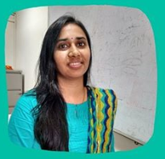



About Myself..
Google Developer Expert in Machine Learning
Organizer of TensorFlow User Community in Hyderabad, India
Area of interest includes Machine learning, deep learning, Natural language processing and speech recognition
Follow me on social media
@sriran_ramkrish
Sriranjani Ramakrishnan

Slide 3
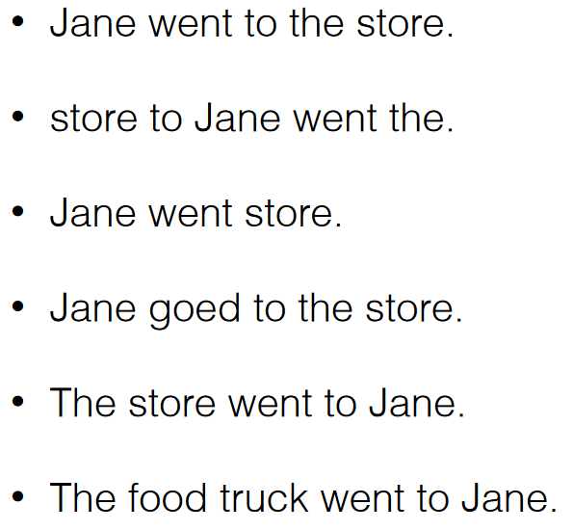
Are these Sentences ok?

Slide 4
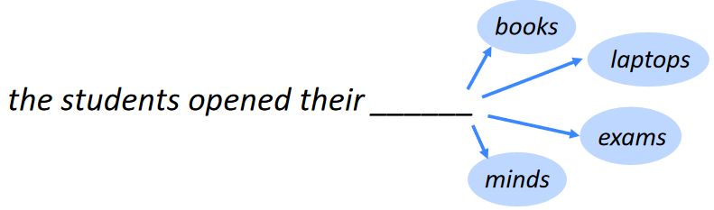
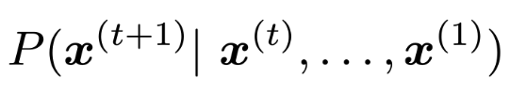
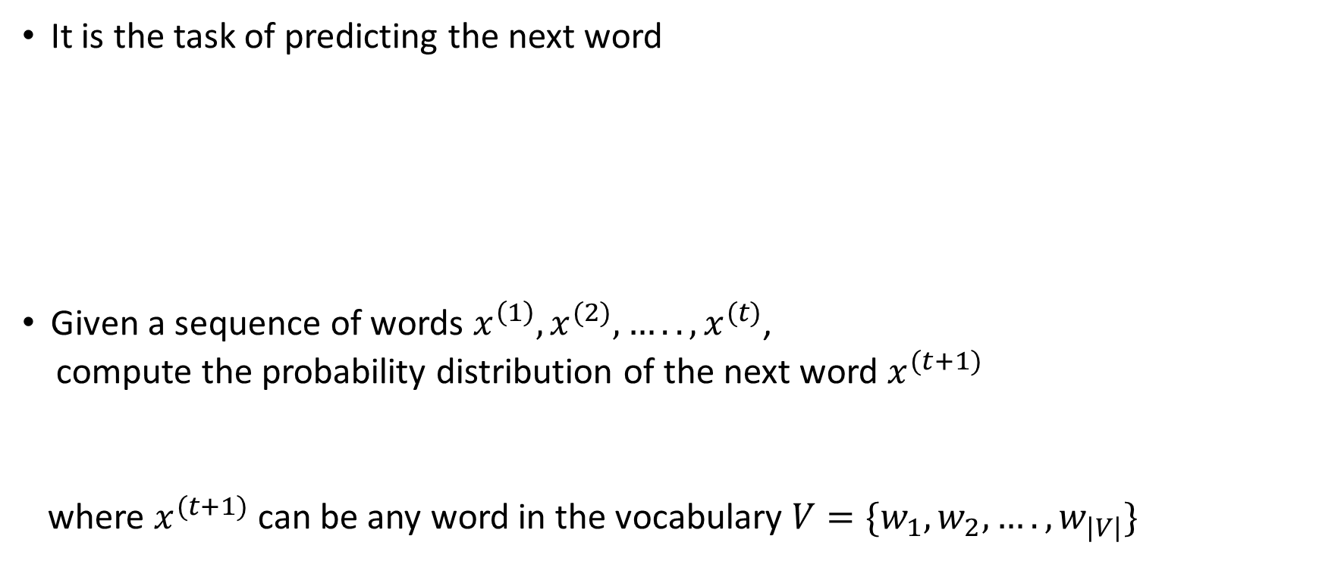
What is Language Modeling?
It is the task of predicting the next word
Given a sequence of words $x^{\left(1\right)},x^{(2)},…..,x^{(t)}$,
compute the probability distribution of the next word $x^{(t+1)}$
where $x^{(t+1)}$ can be any word in the vocabulary $V=\{w_{1},w_{2},….,w_{|V|}\}$

Slide 5
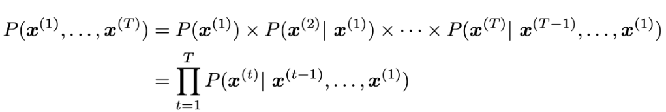
What is Language Modeling?
Language models as a system assigns probability to a piece of text
P(he likes apples)= P(he)P(likes|he)P(apples|likes,he)
Hence we can compare different ordering/ choice of words
P(he likes apples) > p(apples likes he)
P(he likes apples) > p(he licks apples)

Slide 6
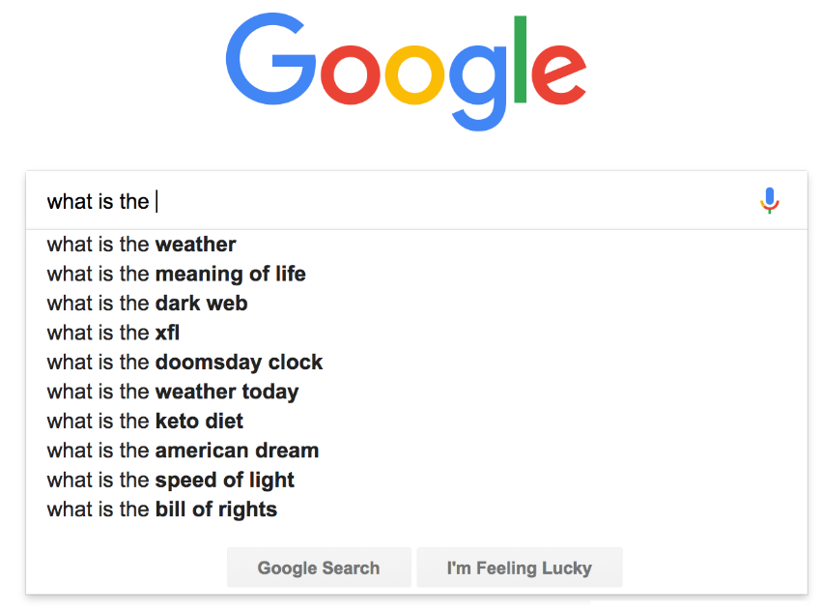
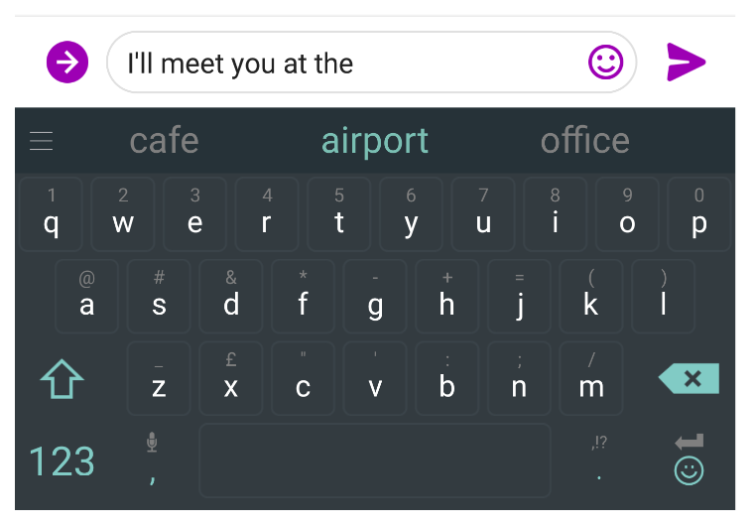
Applications of Language Models

Slide 7




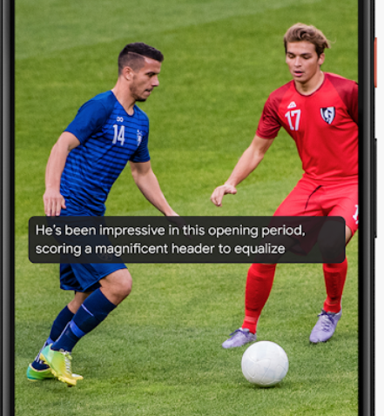
Applications of Language Models
Other Tasks includes
Speech recognition
Machine translation
Image captioning
Spelling correction
Text summarization etc….
https://www.pinclipart.com/maxpin/xJobwb/
https://ai.googleblog.com/2019/10/on-device-captioning-with-live-caption.html
https://apkpure.com/spell-checker-keyboard-%E2%80%93-spelling-correction/com.spellkeyboard.englishchecker.autocorrect.spelling_keyboard
https://thenounproject.com/term/translation/987/
https://icon-library.com/icon/speech-recognition-icon-29.html

Slide 8
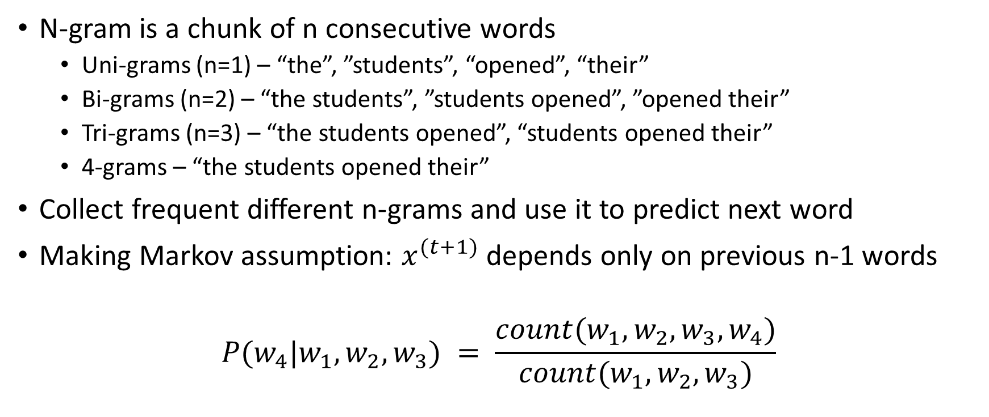
N-gram Language Models
N-gram is a chunk of n consecutive words
Uni-grams (n=1) – “the”, ”students”, “opened”, “their”
Bi-grams (n=2) – “the students”, ”students opened”, ”opened their”
Tri-grams (n=3) – “the students opened”, “students opened their”
4-grams – “the students opened their”
Collect frequent different n-grams and use it to predict next word
Making Markov assumption: $x^{(t+1)}$ depends only on previous n-1 words
$$P(w_{4}|w_{1},w_{2},w_{3}) = \frac{count(w_{1},w_{2},w_{3},w_{4})}{count(w_{1},w_{2},w_{3})}$$

Slide 9
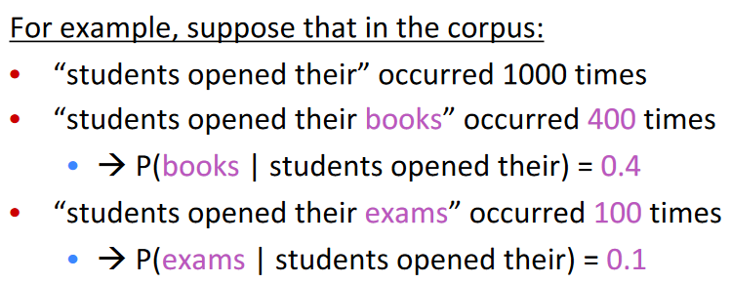
N-gram Language models

Slide 10
Issues with N-gram Language Models
Sparsity Problems
What if “students opened their w” never occurred in data? Then w has probability 0
Add small delta to count for every w – Smoothing
What if “students opened their” never occurred in data? Then we can’t calculate probability for any w
Condition on “opened their” instead – Backoff
Need to store count for all n-grams
Cannot share strength among similar words (bought/purchased a car/bike)
Cannot condition on context with intervening words (Dr. Jane/John Smith)
Cannot handle long distance dependencies

Slide 11
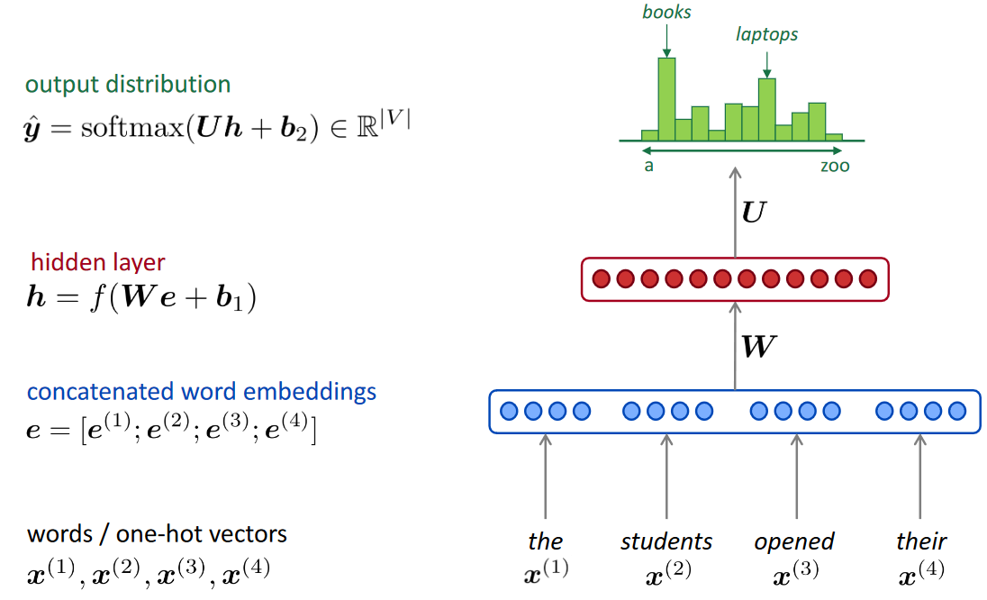
Fixed-Window Neural Language Model
Y. Bengio, et al. (2000/2003): A Neural Probabilistic Language Model

Slide 12
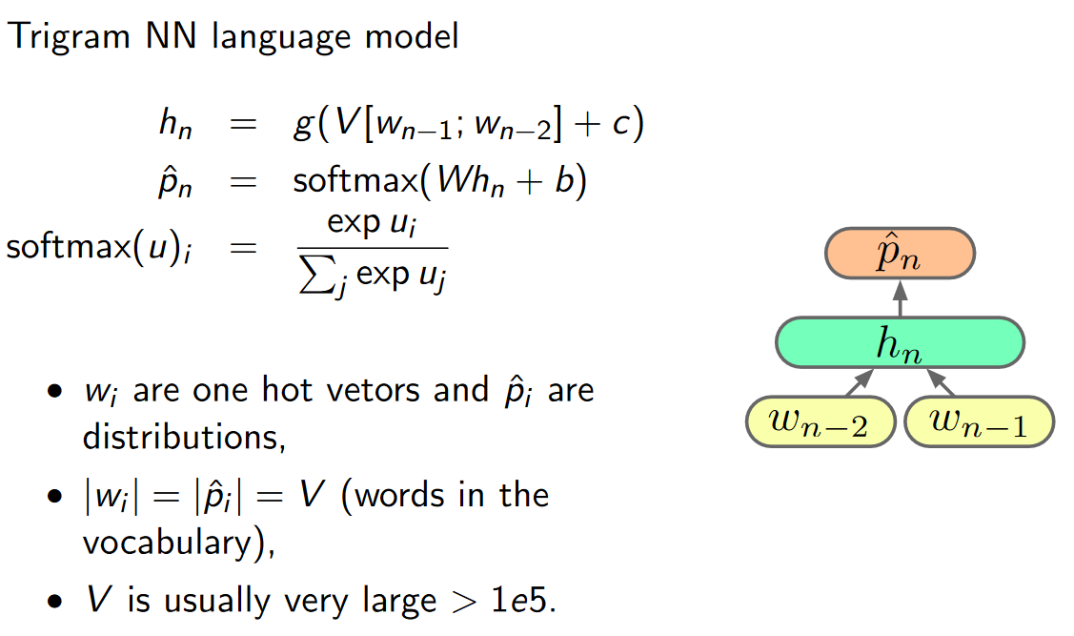
Neural Language Models

Slide 13
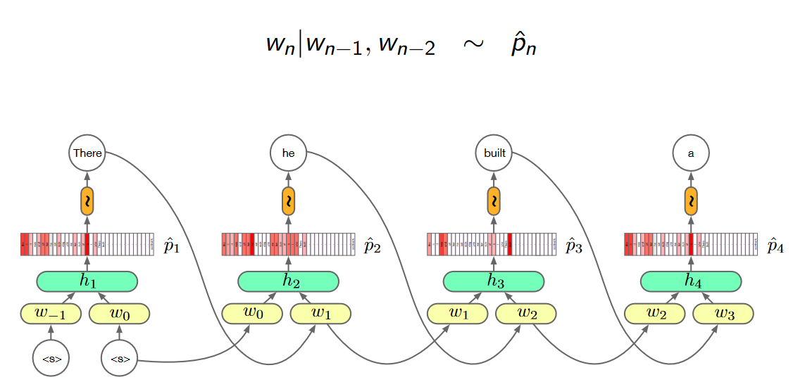
Neural Language Models

Slide 14
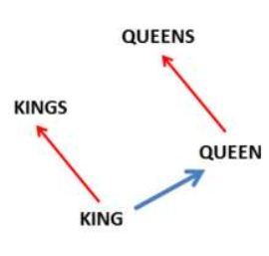
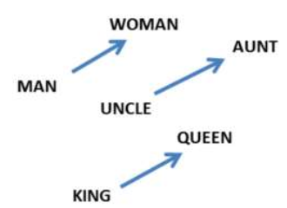
Fixed-Window Neural Language Models
Training with backpropagation
Gradients are calculated in parallel at each time step and summed
Words that occur in similar contexts tend to have similar embeddings
Mikolov et al. 2013
Bengio et.al. 2003

Slide 15
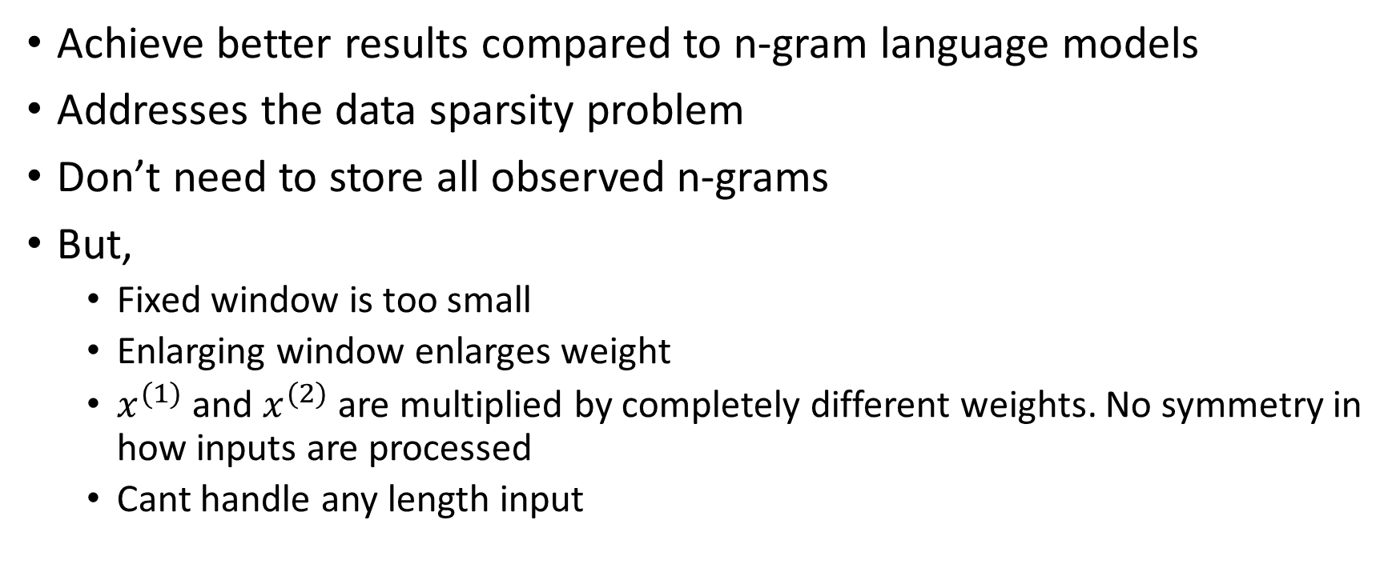
Fixed-Window Neural Language Models
Achieve better results compared to n-gram language models
Addresses the data sparsity problem
Don’t need to store all observed n-grams
But,
Fixed window is too small
Enlarging window enlarges weight
$x^{(1)}$ and $x^{(2)}$ are multiplied by completely different weights. No symmetry in how inputs are processed
Cant handle any length input

Slide 16
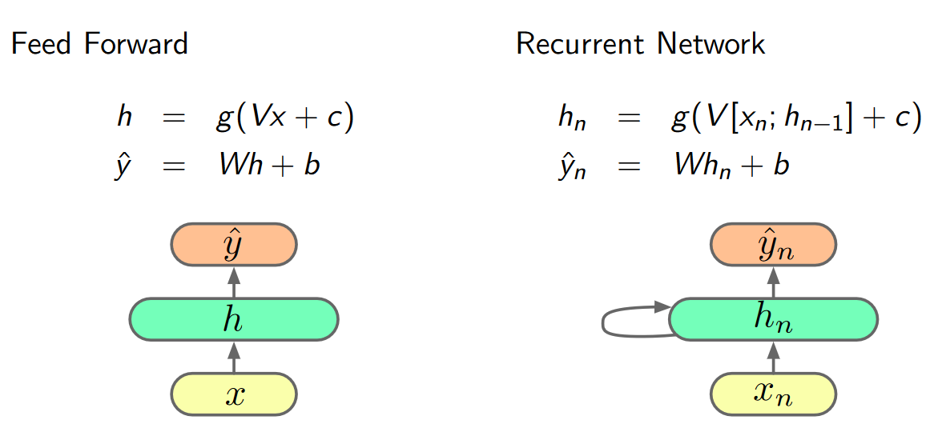
Recurrent Neural Network Language Models

Slide 17
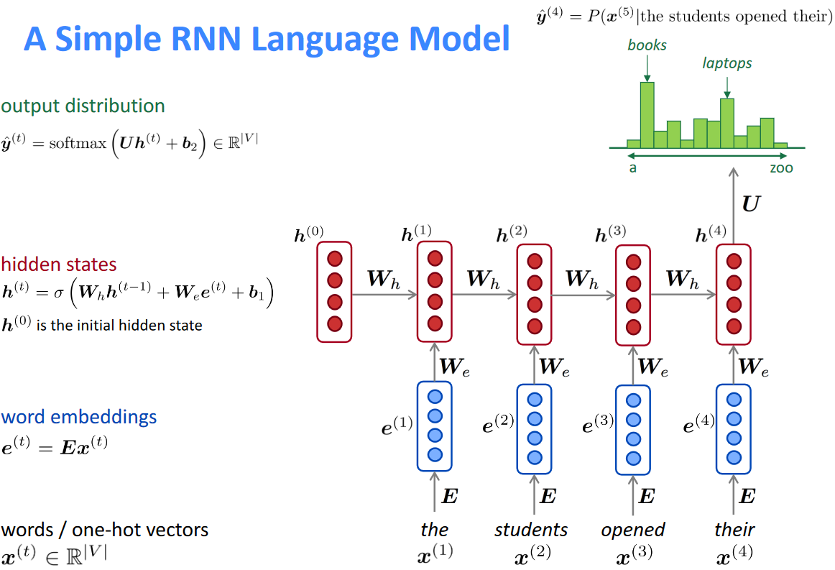
Recurrent neural network(RNN) Language Models (LM)

Slide 18
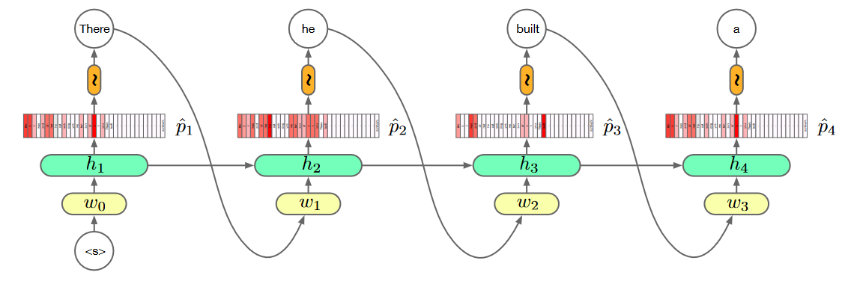
RNN Language Models

Slide 19
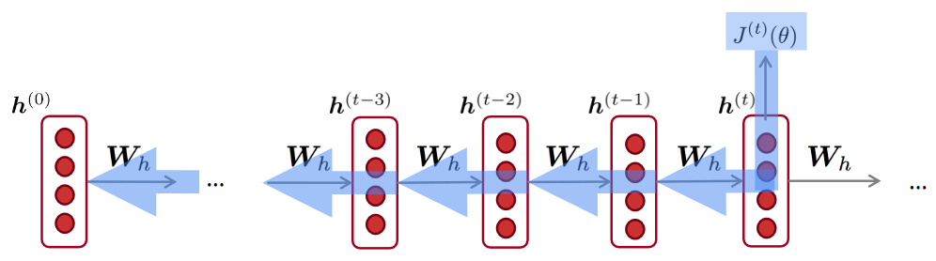
RNN Language Models
Can process any length input
Model size does not increase for longer input
Same weights are applied on every timestep, so symmetry in how inputs are processed
Training using Backpropagation through time (BPTT)/ Truncated BPTT version of it
Loss function is cross-entropy between predicted probability distribution and true next word

Slide 20
RNN Language Models
Due to the issue of vanishing/exploding gradients in RNN,
other popular frameworks like Long-short term memory (LSTM), Gated Recurrent units (GRU),
Bidirectional RNN, Deep RNN and much more .. are being used
Improve RNN LM training using
Optimization like Adam, Adagrad
Minibatch
Regularization methods like dropout
Computational cost is a function of size of vocabulary
Sub-word language modeling

Slide 21
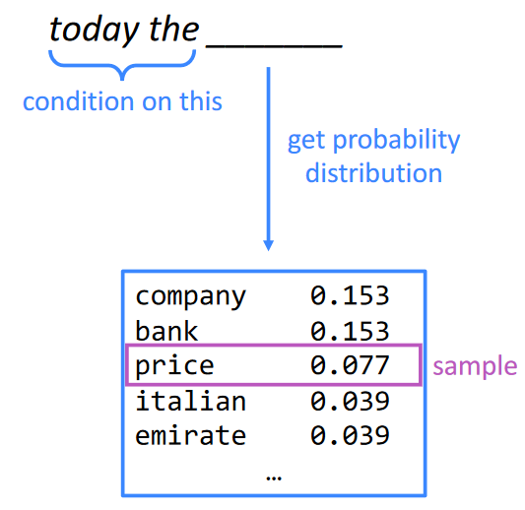
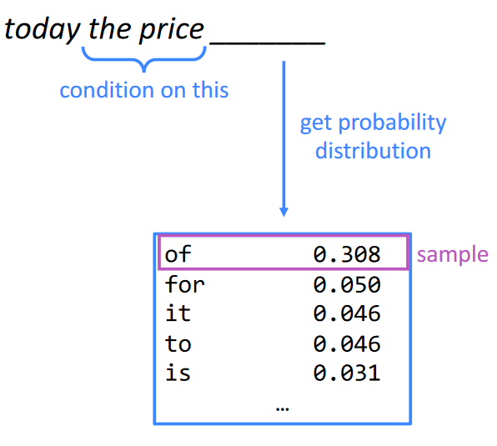
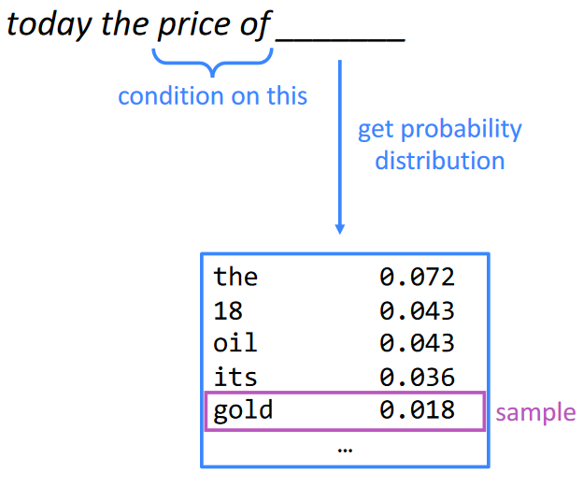
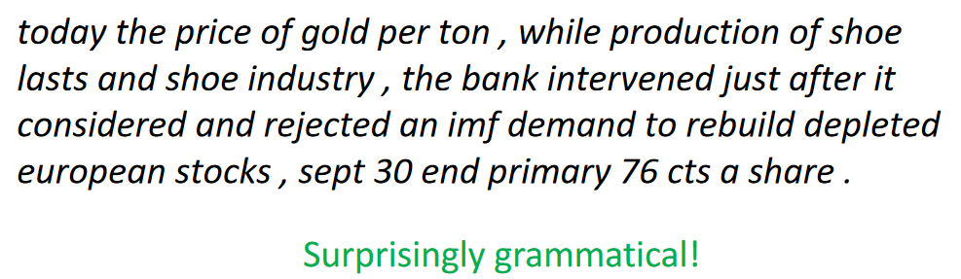
Generating text with n-gram Language Models

Slide 22
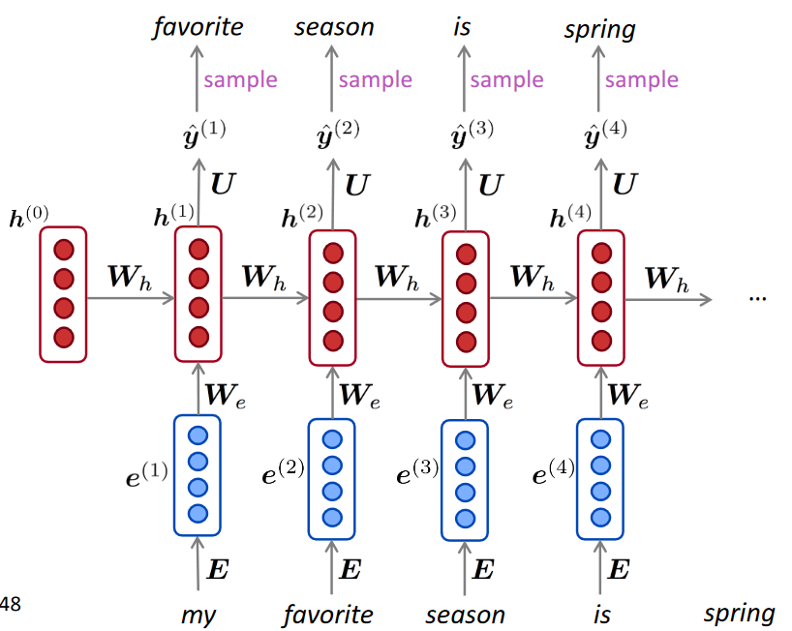
Generating text with RNN Language Models
Using RNN language model to generate text by repeated sampling
Sampled output is next step’s input
You can train RNN – LM on any kind of text, then generate text in that style

Slide 23
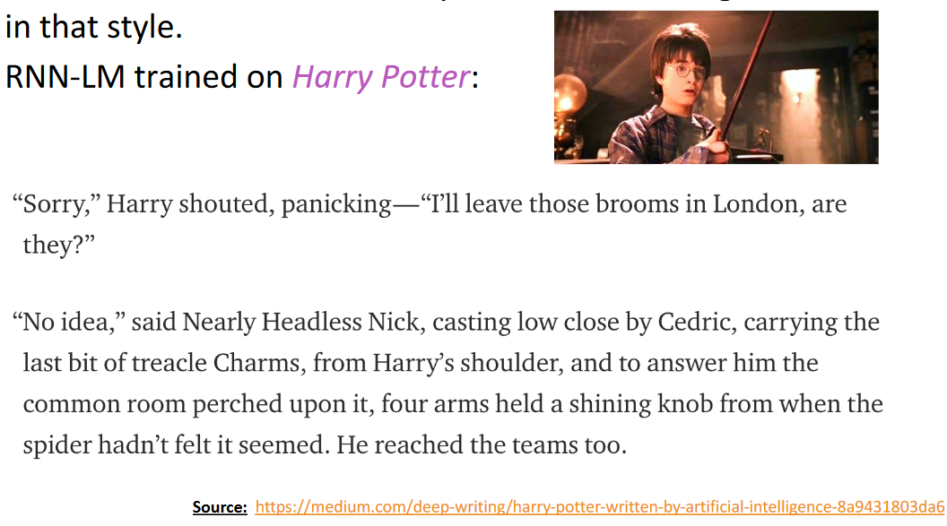
Generating text with RNN Language Models

Slide 24
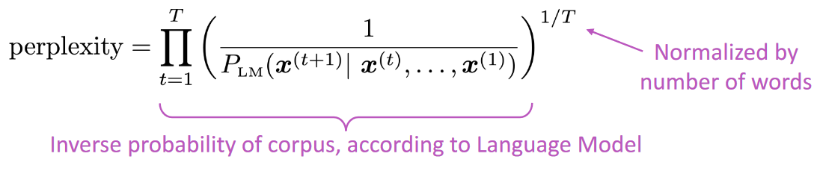
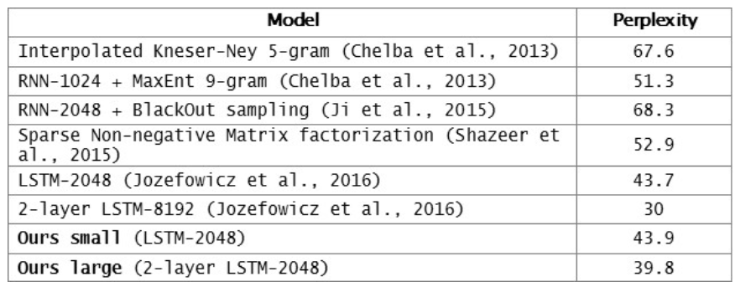
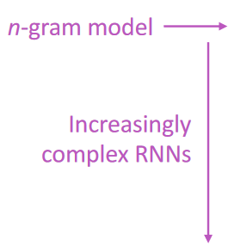
Evaluating Language Models
Standard evaluation metric is perplexity. Lower perplexity is better
https://research.fb.com/building-an-efficient-neural-language-model-over-a-billion-words/

Slide 25
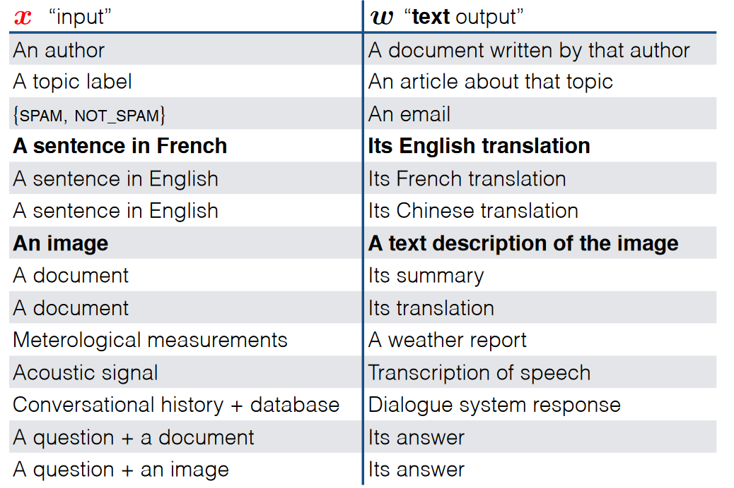
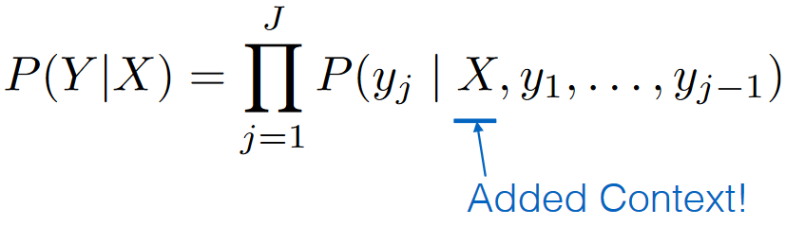
Conditional language models
In conditional language models, the probabilities are assigned to sequence of words given some conditioning context(x)

Slide 26
Conditional language models
To train conditional language models, we need paired samples
Used in Machine translation, Speech recognition, summarization, caption generation etc..
Evaluation of the models
Compare the model’s most likely output to human-generated expected output using a task-specific evaluation metric
Examples of scores: BLEU, METEOR, WER, ROUGE

Slide 27
Summary
Language models (LM) are systems that predict the next word
Language Modeling is a benchmark test that helps us measure progress on understanding language
Neural language models provides much better perplexity than n-gram language models
RNN and its variants are a great way to build LM
Apart from predicting next word, we can generate text using LM
Using conditional language models, we can predict next word using previously generated words and some conditioning context
The LMs are evaluated using Perplexity or task – based scores

Slide 28
Slide Credits and References
Images are taken from the courses:
CS224N lectures by Stanford
NLP lectures by Oxford
Neural Networks for NLP lectures by CMU
References
Bengio, Y., Ducharme, R., Vincent, P., & Janvin, C. (2003). A Neural Probabilistic Language Model. The Journal of Machine Learning Research, 3, 1137–1155.
Mikolov, T., Corrado, G., Chen, K., & Dean, J. (2013). Efficient Estimation of Word Representations in Vector Space. Proceedings of the International Conference on Learning Representations (ICLR 2013), 1–12
Mikolov, T., Chen, K., Corrado, G., & Dean, J. (2013). Distributed Representations of Words and Phrases and their Compositionality. NIPS, 1–9.
https://machinelearningmastery.com/develop-word-based-neural-language-models-python-keras/

